Slide 1
Chapter 2:
NEWTON’S FIRST LAW OF MOTION—INERTIA

Slide 2
This lecture will help you understand:
Aristotle’s Ideas of Motion
Galileo’s Concept of Inertia
Newton’s First Law of Motion
Net Force
The Equilibrium Rule
Support Force
Equilibrium of Moving Things
The Moving Earth

Slide 3
Aristotle’s Ideas of Motion
Aristotle’s classification of motion
(Natural and Violent)
Natural motion
  Every object in the universe has a proper place determined by a combination of four elements: earth, water, air, and fire.
  Any object not in its proper place will strive to get there.
  Examples:
    Stones fall.
    Puffs of smoke rise.

Slide 4
Aristotle’s Ideas of Motion
Natural motion (continued)
  Straight up or straight down for all things on Earth.
  Beyond Earth, motion is circular.
  Example: The Sun and Moon continually circle Earth.
Violent motion
  Produced by external pushes or pulls on objects.
  Example: Wind imposes motion on ships.

Slide 5
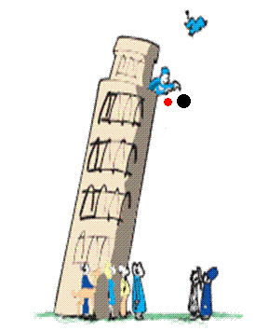
Galileo’s Concept of Inertia
Galileo demolished Aristotle’s assertions in the early 1500s.
Galileo’s discovery:
  Objects of different weight fall to the ground at the same time in the absence of air resistance.
  A moving object needs no force to keep it moving in the absence of friction.

Slide 6
Galileo’s Inclined Planes
Aristotle did not consider motion in a vacuum. Therefore, an object needs a pull or push to keep moving.
Galileo denied this principle and stated that if there is no interference with a moving object, it will keep moving in a straight line forever; no push, pull and any kind of force is necessary. In the absence of retarding forces, the object has a tendency to move forever without slowing down.

Slide 7
Galileo’s Concept of Inertia
Force
is a push or a pull.
Inertia
is a property of matter to resist changes in motion.
depends on the amount of matter in an object (its mass).

Slide 8
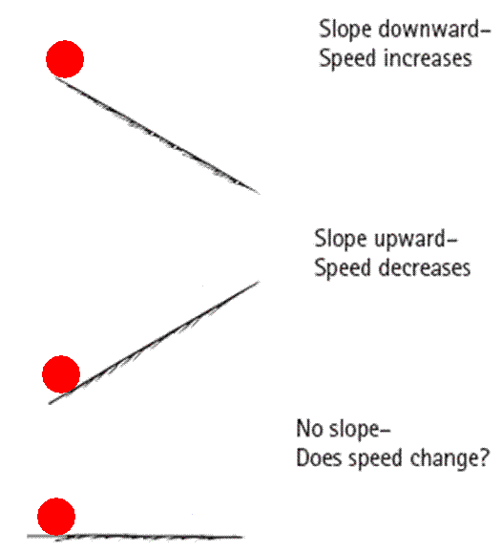
Galileo’s Concept of Inertia
Balls rolling on downward-sloping planes picked up speed.
Balls rolling on upward-sloping planes lost speed.
So a ball on a horizontal plane must maintain speed forever.
If the ball comes to rest, it is not due to its “nature,” but due to friction.

Slide 9
Galileo’s Concept of Inertia
The property of an object to resist changes in motion is called Inertia
Inertia depends on the amount of matter in an object (its mass).

Slide 10
Galileo’s Concept of Inertia
CHECK YOUR NEIGHBOR
The use of inclined planes for Galileo’s experiments helped him to
eliminate the acceleration of free fall.
discover the concept of energy.
discover the property called inertia.
discover the concept of momentum.
Notes:
Answer: C

Slide 11
Galileo’s Concept of Inertia
CHECK YOUR NEIGHBOR
The use of inclined planes for Galileo’s experiments helped him to
eliminate the acceleration of free fall.
discover the concept of energy.
discover the property called inertia.
discover the concept of momentum.
Comment:
Note that inertia is a property of matter, not a reason for the behavior of matter.
Notes:
Inertia is a property of matter.
It is not a reason for the behavior of matter.

Slide 12
Newton’s First Law of Motion
Every object continues in a state of rest or of uniform speed in a straight line unless acted on by a nonzero net force.
Objects won’t move or change motion without a net force being applied.
Notes:
The key word in this law is continues: An object continues to do whatever it happens to be doing unless a force is exerted upon it.
If it is at rest, it continues in a state of rest.
If an object is moving, it continues to move without turning or changing its speed.

Slide 13
Net Force
Force is a push or a pull
Force is a Vector quantity
Vectors:
are a quantity whose description requires both magnitude (how much) and direction (which way)
can be represented by arrows drawn to scale, called vectors
  length of arrow represents magnitude and arrowhead shows direction
  Examples: force, velocity, acceleration

Slide 14
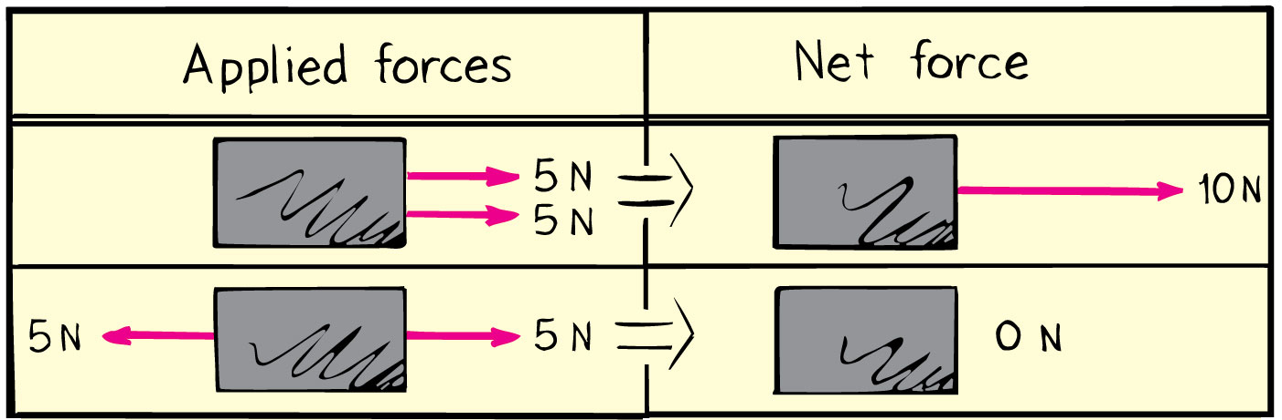
Net Force
Net force is the combination of all forces that change an object’s state of motion.
Example: If you pull on a box with 10 N and a friend pulls oppositely with 5 N, the net force is 5 N in the direction you are pulling.

Slide 15
Net Force
CHECK YOUR NEIGHBOR
A cart is pushed to the right with a force of 15 N while being pulled to the left with a force of 20 N. The net force on the cart is
5 N to the left.
5 N to the right.
25 N to the left.
25 N to the right.
Notes:
Answer: A

Slide 16
Net Force
CHECK YOUR NEIGHBOR
A cart is pushed to the right with a force of 15 N while being pulled to the left with a force of 20 N. The net force on the cart is
5 N to the left.
5 N to the right.
25 N to the left.
25 N to the right.
Two forces are in opposite directions, so they subtract.
The direction is determined by the direction of the larger force.
Notes:
When you take a 15N force to the right added to a 20 N force to the left, because the two forces are in opposite directions, they in fact subtract, rather than add.
So, the larger 20 force to the left is cut back by the 15N force to the right, so that the remaining force i.e. the Net force is only 5N to the left.

Slide 17
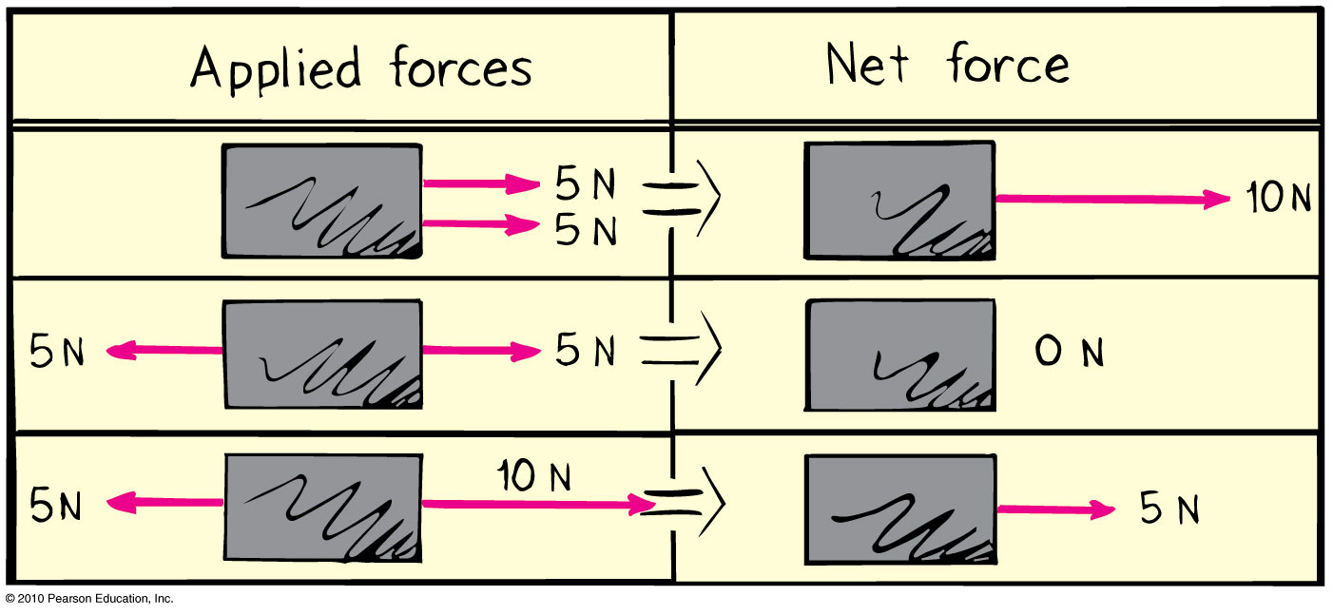
Net Force
CHECK YOUR NEIGHBOR
What is the net force acting on the box?
15 N to the left
15 N to the right
5 N to the left
5 N to the right
?
Notes:
Answer: D

Slide 18
Net Force
CHECK YOUR NEIGHBOR
What is the net force acting on the box?
15 N to the left
15 N to the right
5 N to the left
5 N to the right
Notes:
When you take a 10N force to the right added to a 5 N force to the left, because the two forces are in opposite directions, they in fact subtract, rather than add.
So, the larger 10N force to the right is cut back by the 5N force to the left, so that the remaining force i.e. the Net force is only 5N to the right.

Slide 19
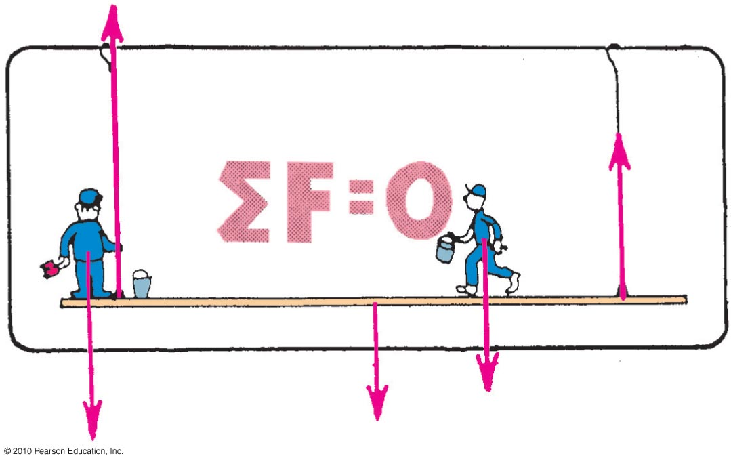
The Equilibrium Rule
The vector sum of forces acting on a non-accelerating object equals zero.
In equation form: ΣF = 0.

Slide 20
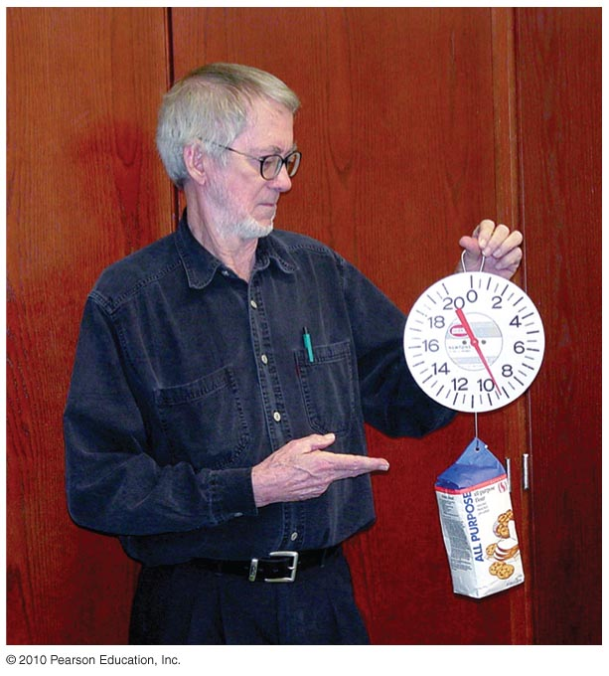
The Equilibrium Rule : Example
A string holding up a bag of flour
Two forces act on the bag of flour:
  Tension force acts upward.
  Weight acts downward.
Both are equal in magnitude and opposite in direction.
  When added, they cancel to zero.
  So, the bag of flour remains at rest.

Slide 21
The Equilibrium Rule
CHECK YOUR NEIGHBOR
The equilibrium rule, ΣF = 0, applies to
vector quantities.
scalar quantities.
Both of the above.
None of the above.
Notes:
Answer: A

Slide 22
The Equilibrium Rule
CHECK YOUR NEIGHBOR
The equilibrium rule, ΣF = 0, applies to
vector quantities.
scalar quantities.
Both of the above.
None of the above.
Explanation:
Vector addition accounts for + and – quantities.
So, two vectors in opposite direction can add to zero.
Notes:
Vector addition takes into account the signs of quantities. So quantities, such as forces can be either positive or negative. In this way, two forces (forces), one positive and the other negative, can add to zero. But there is no way that two masses (scalars) can add to zero.

Slide 23
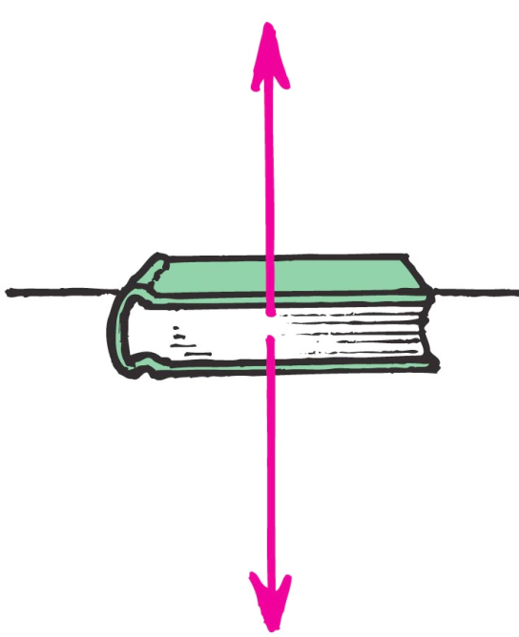
Support Force
Support force (normal force) is an upward force on an object that is opposite to the force of gravity.
Example: A book on a table compresses
Atoms in the table, and the compressed
atoms produce the support force.

Slide 24
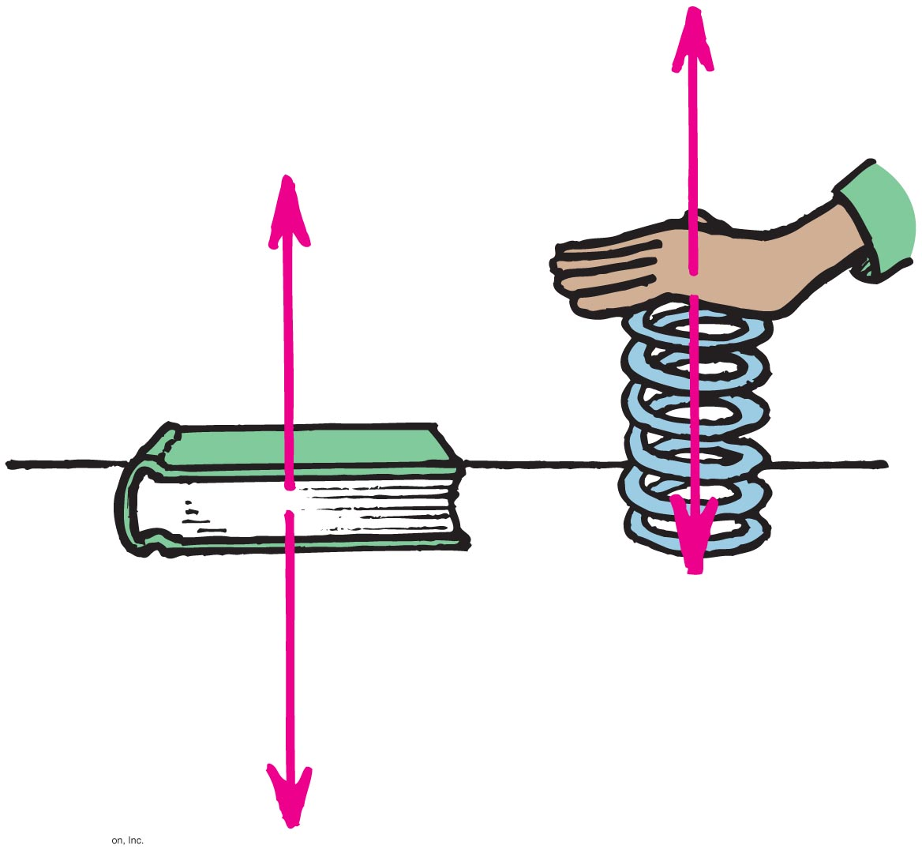
Understanding Support Force
When you push down on a spring, the spring pushes back up on you.
Similarly, when a book pushes down on a table, the table pushes back up on the book.

Slide 25
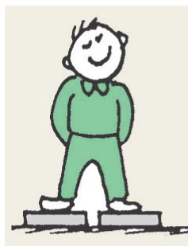
Support Force
CHECK YOUR NEIGHBOR
When you stand on two bathroom scales with one foot on each scale and with your weight evenly distributed, each scale will read
your weight.
half your weight.
zero.
more than your weight.
Notes:
Answer: B

Slide 26
Support Force
CHECK YOUR NEIGHBOR
When you stand on two bathroom scales with one foot on each scale and with your weight evenly distributed, each scale will read
your weight.
half your weight.
zero.
more than your weight.
Explanation:
You are at rest, so ΣF=0.
Forces from both scales add to cancel your weight.
Force from each scale is one-half your weight
Notes:
You are at rest on the scales, so ΣF = 0. The sum of the two upward support forces is equal to your weight.
Your weight is distributed over the two scales. So, each scale reads half your weight.

Slide 27
Equilibrium of Moving Things
Equilibrium: a state of no change with no net force acting
  Static equilibrium
  Example: hockey puck at rest on slippery ice
  Dynamic equilibrium
  Example: hockey puck sliding at constant speed on slippery ice

Slide 28
The Equilibrium Rule
Equilibrium
Static
Dynamic
Object is at rest. (not moving)
Object moves at a constant velocity
(same speed and same direction)
(= no acceleration)

Slide 29
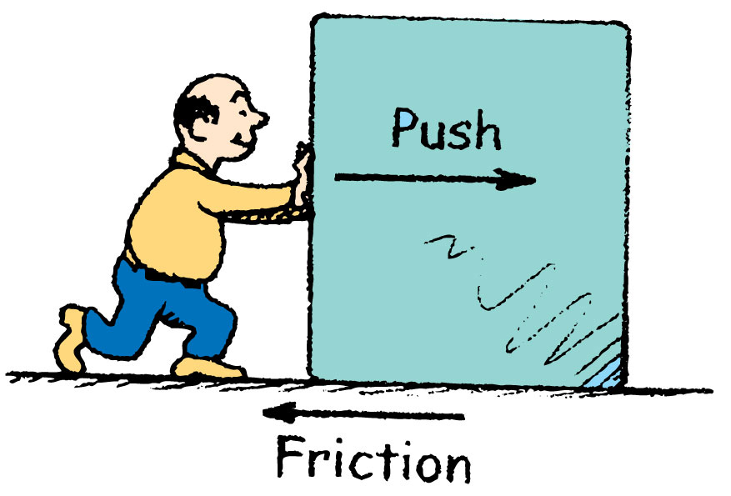
Equilibrium of Moving Things
Equilibrium test: whether something undergoes changes in motion
  Example: A crate at rest is in static equilibrium.
  Example: When pushed at a steady speed, it is in dynamic equilibrium.

Slide 30
Equilibrium of Moving Things
CHECK YOUR NEIGHBOR
A bowling ball is in equilibrium when it
is at rest.
moves steadily in a straight-line path.
Both of the above.
None of the above.
Notes:
Answer: C

Slide 31
Equilibrium of Moving Things
CHECK YOUR NEIGHBOR
A bowling ball is in equilibrium when it
is at rest.
moves steadily in a straight-line path.
Both of the above.
None of the above.
Explanation:
Equilibrium means no change in motion, so there are two options:
If at rest, it continues at rest.
If in motion, it continues at a steady rate in a straight line.
Notes:
For an object to be in equilibrium, it does not necessarily have to be at rest.
It can be in equilibrium as long as it is not changing its motion.
If it is initially at rest it must continue to remain at rest.
If it is initially in motion it must continue in motion at a steady rate in a straight line path.

Slide 32
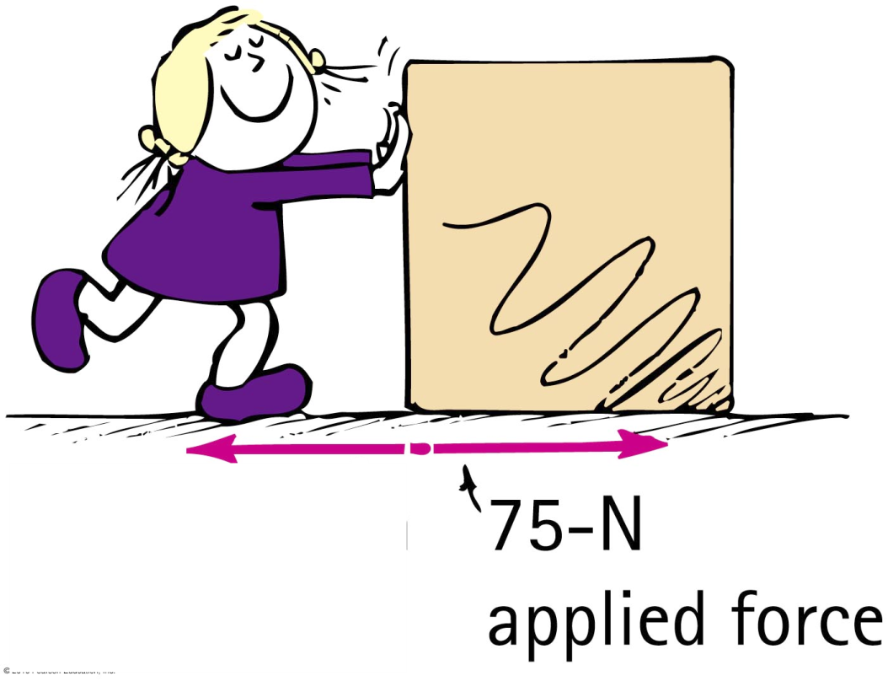
Equilibrium of Moving Things
CHECK YOUR NEIGHBOR
You are pushing a crate at a steady speed in a straight line. If the friction force is 75 N, how much force must you apply?
more than 75 N
less than 75 N
equal to 75 N
not enough information
Notes:
Answer: C

Slide 33
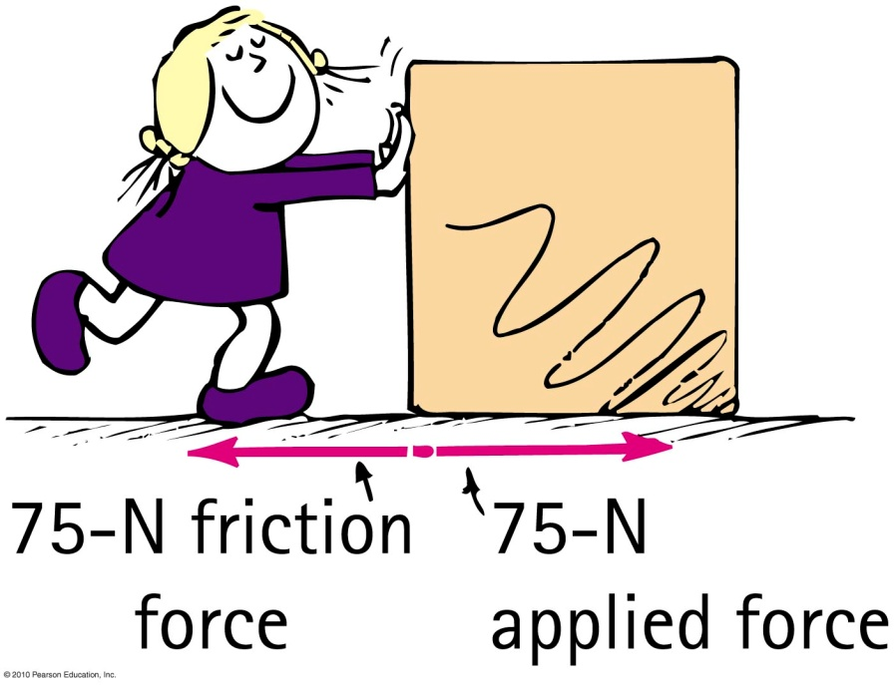
Equilibrium of Moving Things
CHECK YOUR NEIGHBOR
You are pushing a crate at a steady speed in a straight line. If the friction force is 75 N, how much force must you apply?
A. more than 75 N
B. less than 75 N
C. equal to 75 N
D. not enough information
Explanation:
The crate is in dynamic equilibrium, so, ΣF = 0.
Your applied force balances the force of friction.
Notes:
Crate is in dynamic equilibrium, So there is no NET force acting on it
So you must apply a force that balances out the force of friction. Which means it must be equal and opposite to the force of friction. So if Friction is 75N to the left, the Applied Force from you is 75N to the right.

Slide 34
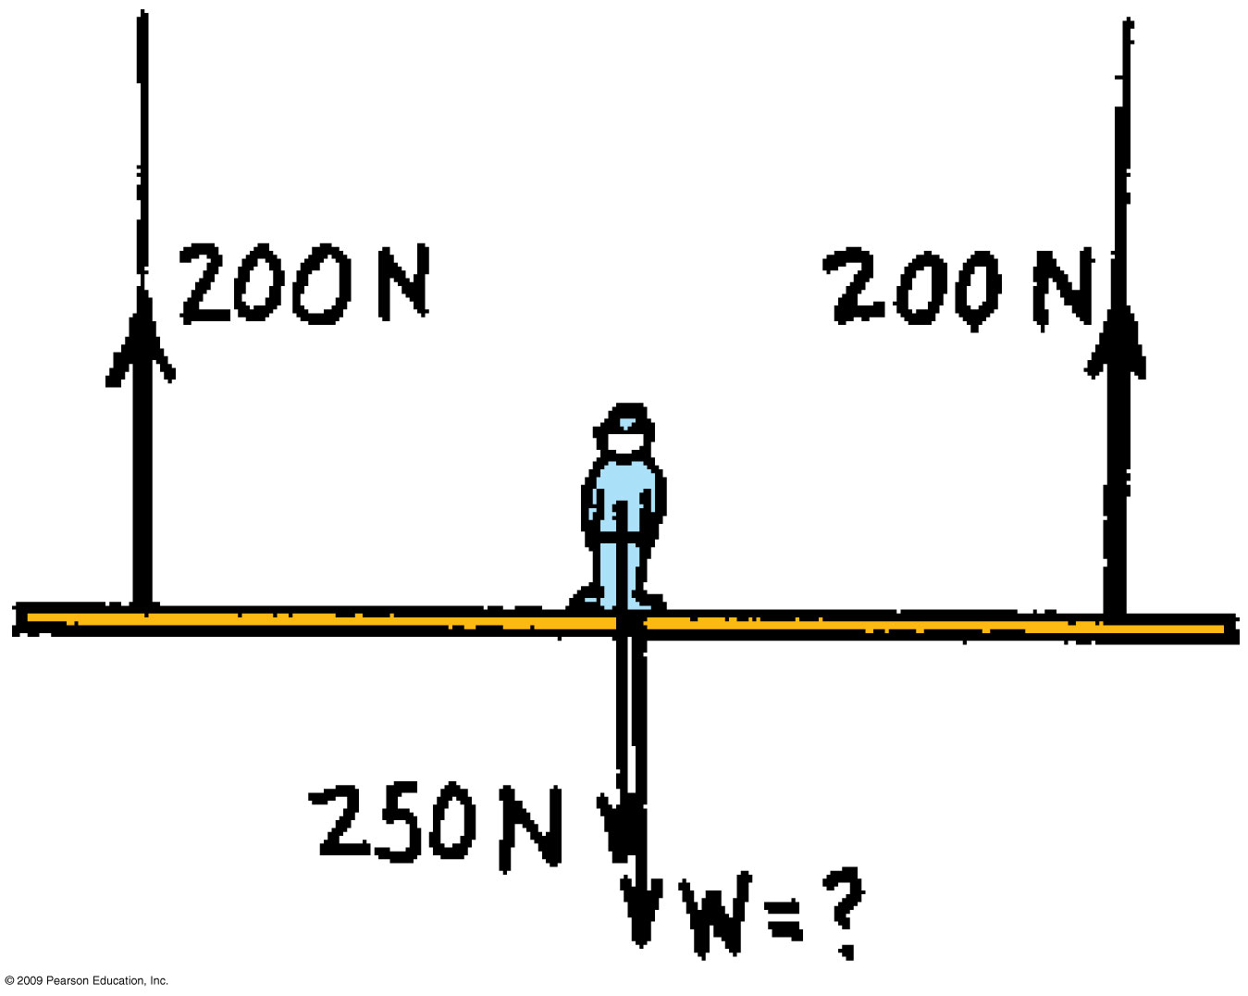
What is the weight of the scaffold?

Slide 35
250 + W = 200 + 200
W = 400 – 250 = 150 N

Slide 36
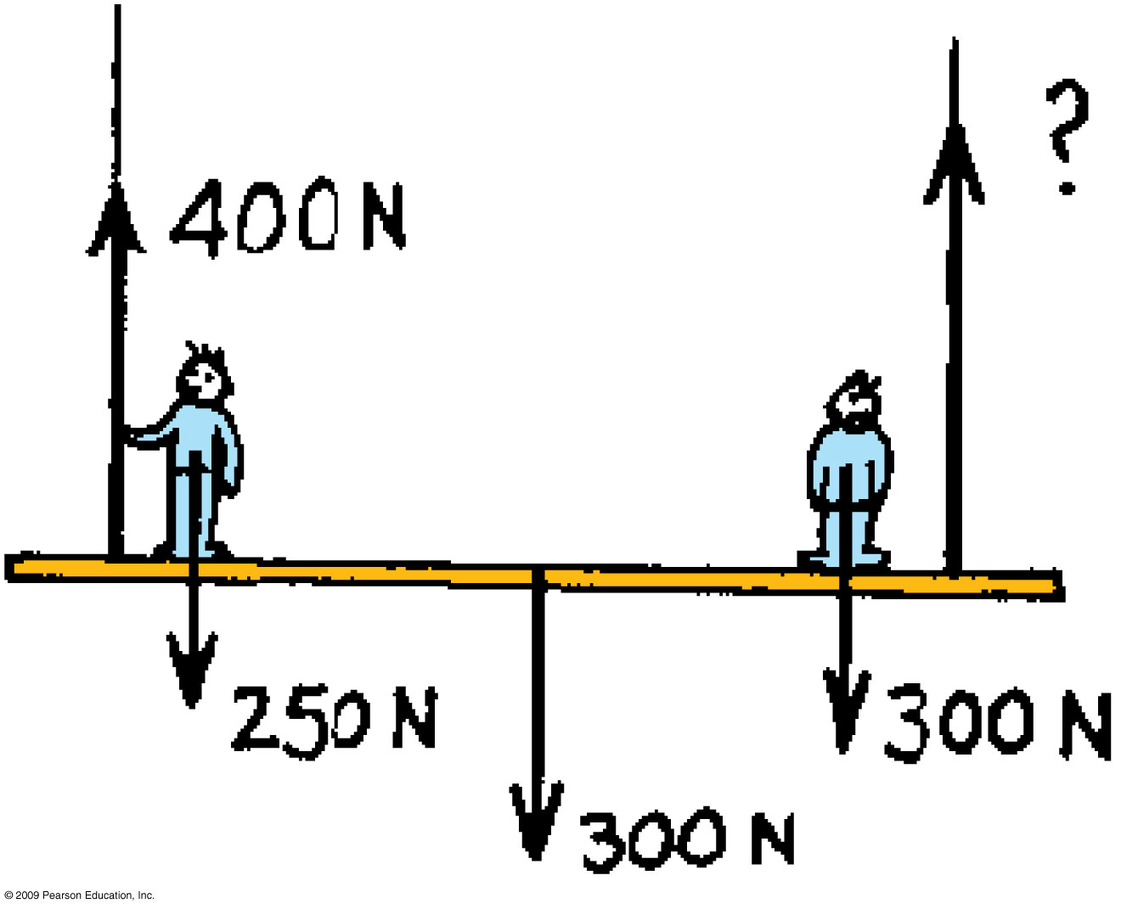

Slide 37
400 + ? = 250 + 300 + 300
? = 850 – 400 = 450 N

Slide 38
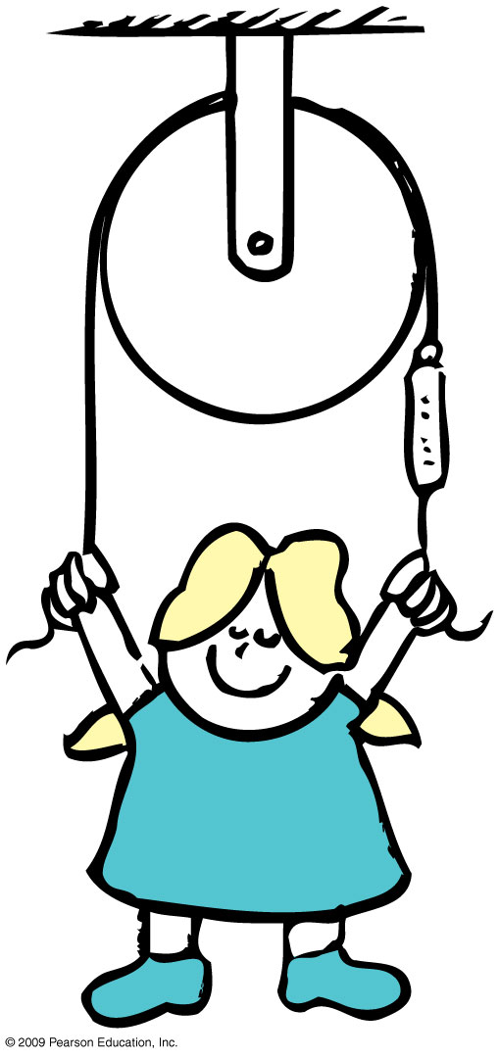
If the girl’s weight is W, and she is in equilibrium, what is the reading on the scale?

Slide 39
If the girl’s weight is W, and she is in equilibrium, what is the reading on the scale?
Scale reading = W/2

Slide 40
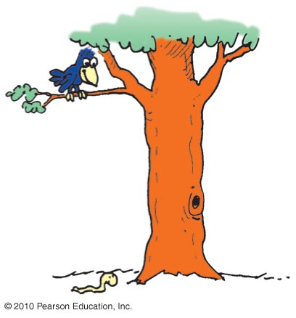
The Moving Earth
Copernicus proposed that Earth was moving.
This idea was refuted by people.
Example: If Earth moved, how can a bird swoop from a branch to catch a worm?
Solution: As it swoops, due to inertia, it continues to go sideways at the speed of Earth along with the tree, worm, etc.

Slide 41
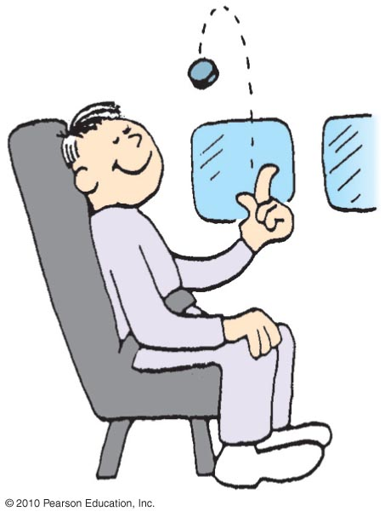
The Moving Earth
CHECK YOUR NEIGHBOR
You are riding in a van at a steady speed and toss a coin up. Where will the coin land?
behind you
ahead of you
back in your hand
There is not enough information.
Notes:
Answer: C

Slide 42
The Moving Earth
CHECK YOUR NEIGHBOR
You are riding in a van at a steady speed and toss a coin up. Where will the coin land?
behind you
ahead of you
back in your hand
There is not enough information.
Explanation:
The coin has inertia. It continues sideways with the van and your hand and lands back in your hand.

Slide 43
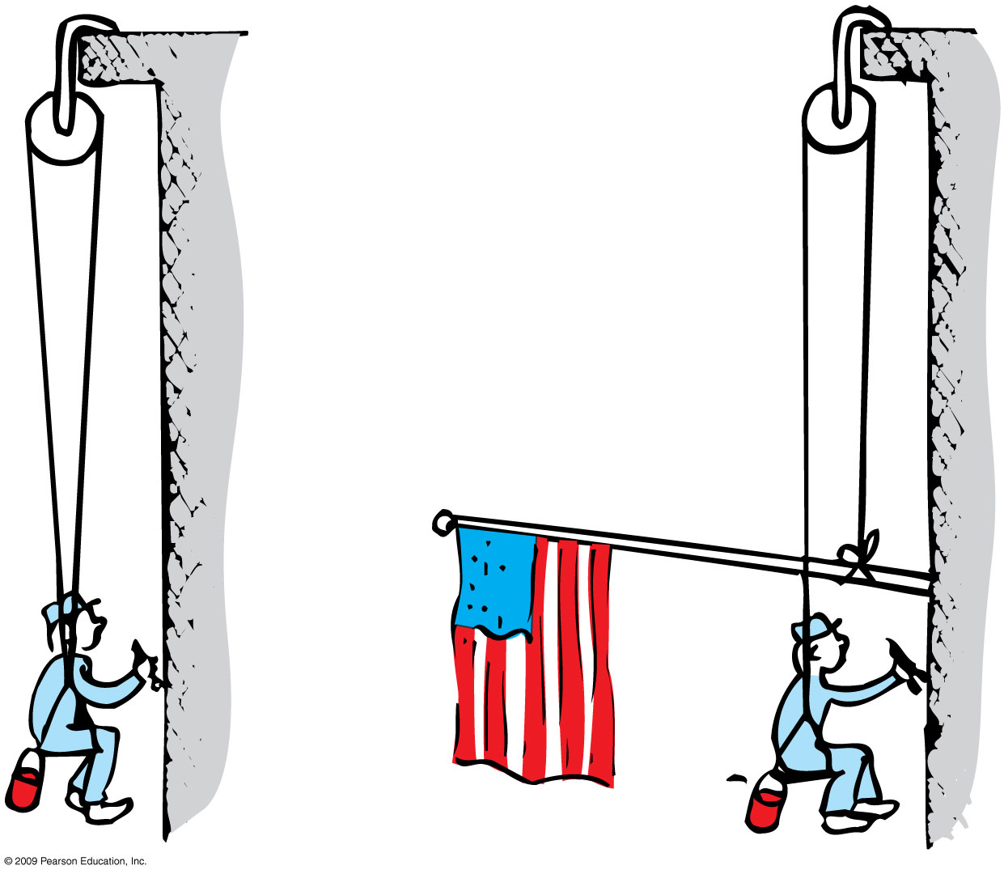
How does the tension in each rope compare?
Which rope is more likely to break

Slide 44
W/2
W

Slide 45
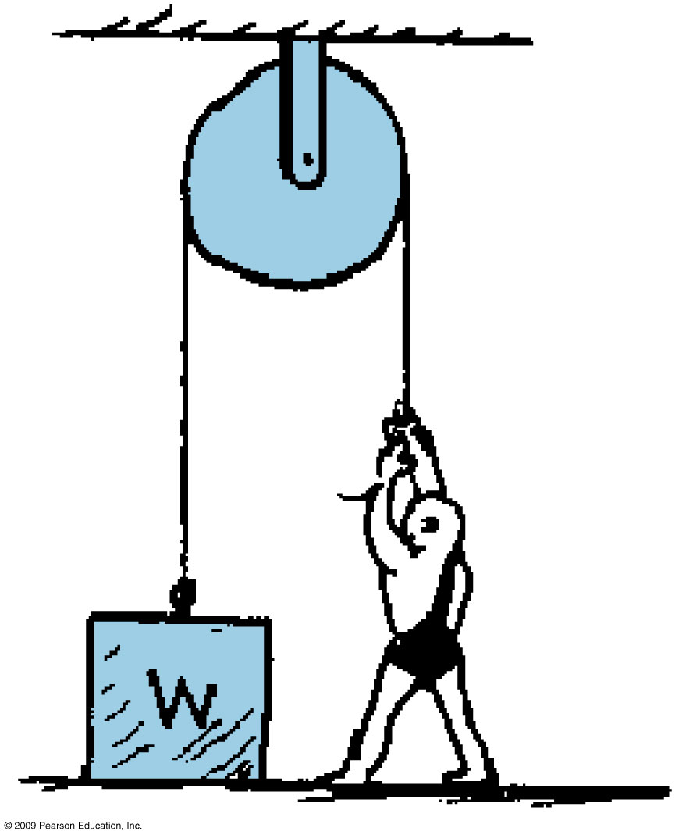
What must the man weigh in order to lift the weight?

Slide 46
What must the man weigh in order to lift the weight?
Wm > W

Slide 47
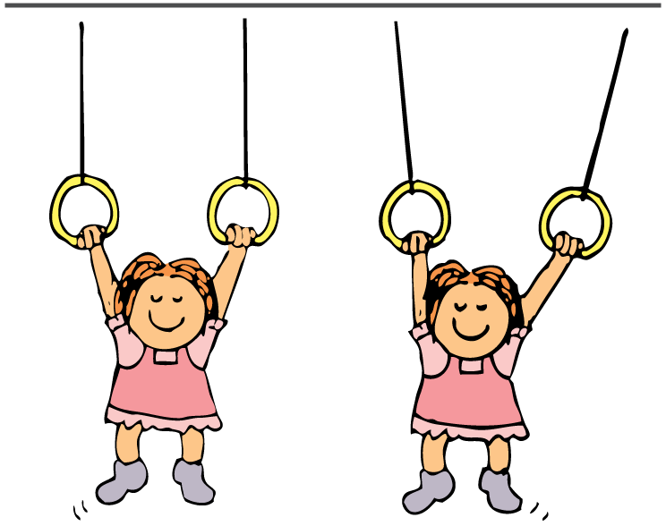
think!
If the gymnast hangs with her weight evenly divided between the two rings, how would scale readings in both supporting ropes compare with her weight? Suppose she hangs with slightly more of her weight supported by the left ring. How would a scale on the right read?
Answer: In the first case, the reading on each scale will be half her weight. In the second case, when more of her weight is supported by the left ring, the reading on the right reduces to less than half her weight. The sum of the scale readings always equals her weight.

Slide 48
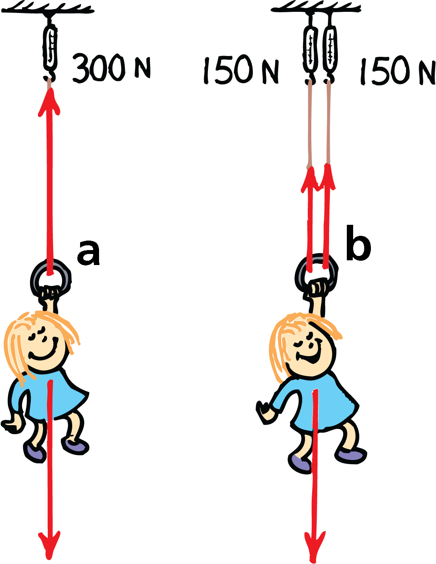
The tension in the rope is 300 N, equal to Nellie’s weight.
The tension in each rope is now 150 N, half of Nellie’s weight. In each case, ΣF = 0.

Slide 49
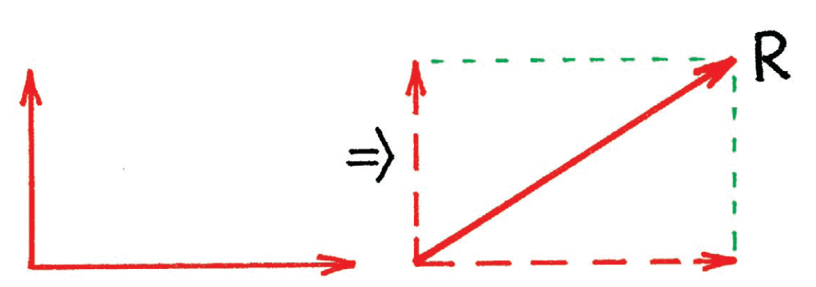
The Parallelogram Rule
To find the resultant of nonparallel vectors, we use the parallelogram rule.
Consider two vectors at right angles to each other, as shown below. The constructed parallelogram in this special case is a rectangle. The diagonal is the resultant R.

Slide 50
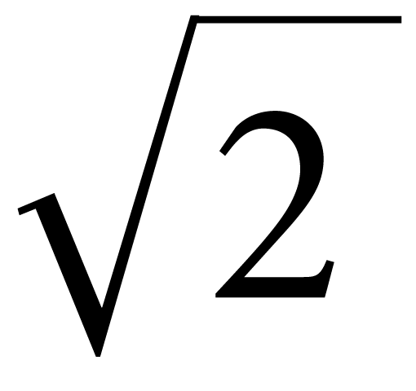
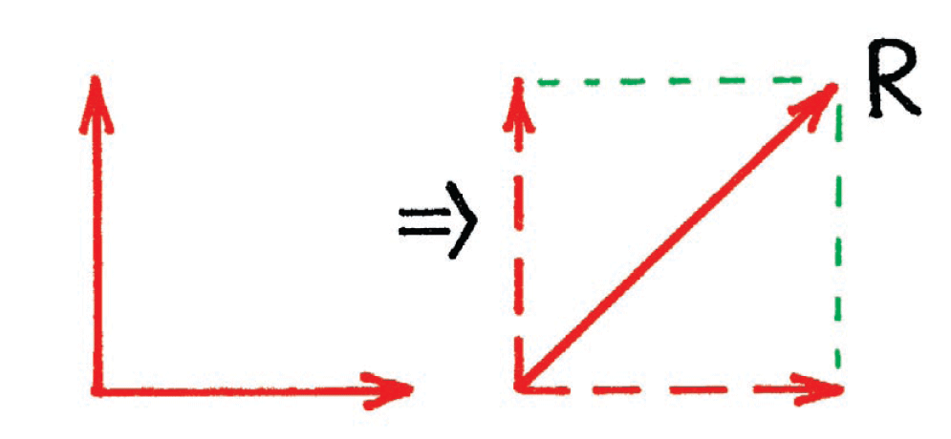
The Parallelogram Rule
In the special case of two perpendicular vectors that are equal in magnitude, the parallelogram is a square.
The resultant is times one of the vectors.
For example, the resultant of two equal vectors of magnitude 100 acting at a right angle to each other is 141.4.

Slide 51
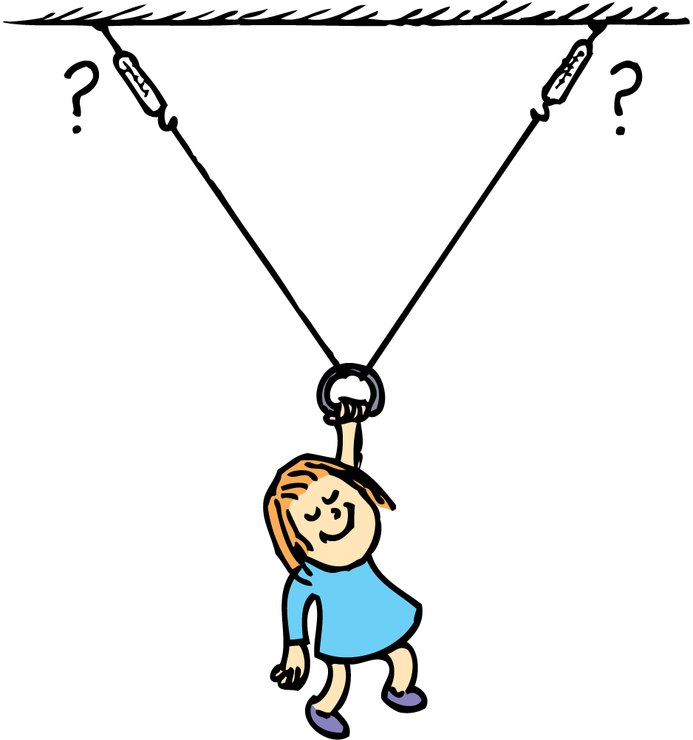
Applying the Parallelogram Rule
When Nellie is suspended at rest from the two non-vertical ropes, is the rope tension greater or less than the tension in two vertical ropes?
You need to use the parallelogram rule to determine the tension.

Slide 52
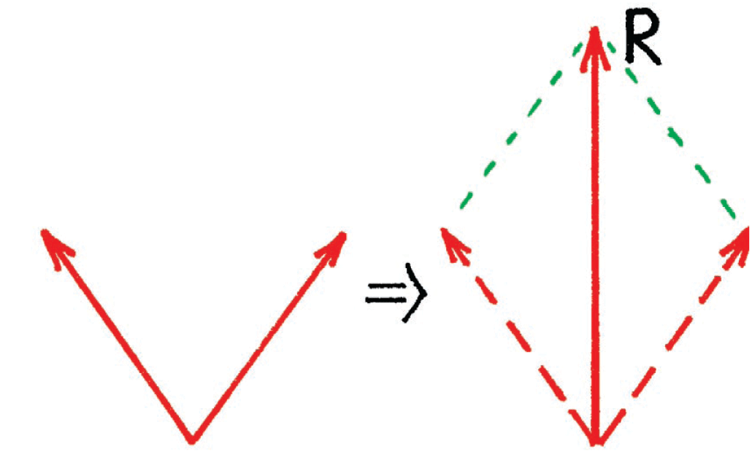
Applying the Parallelogram Rule
Notice how the tension vectors form a parallelogram in which the resultant R is vertical.

Slide 53
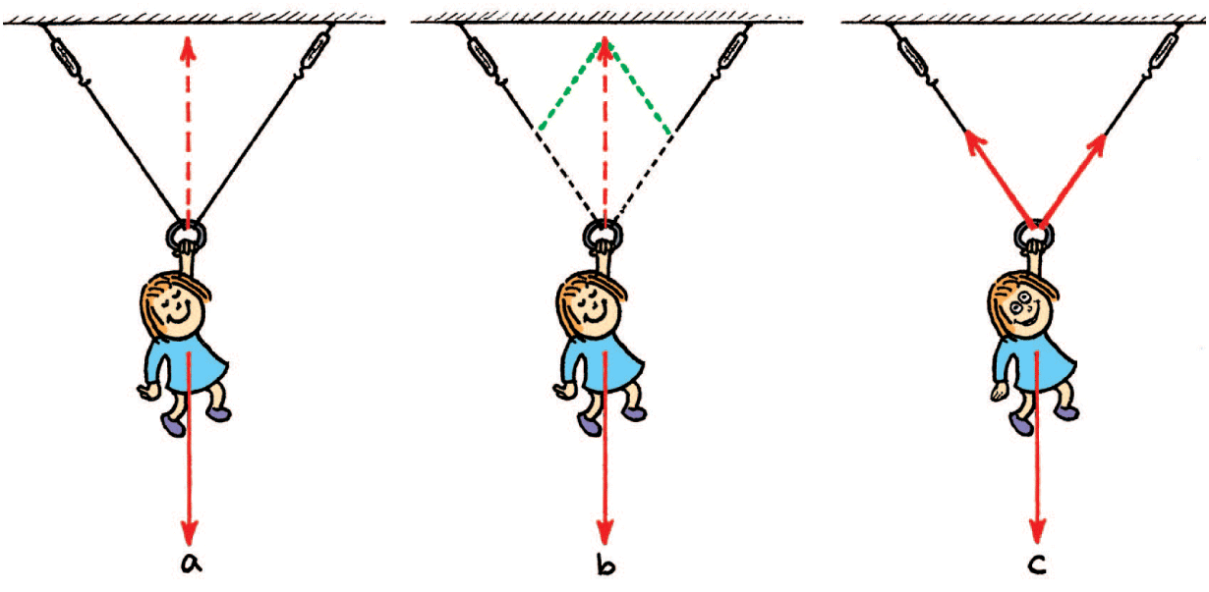
Applying the Parallelogram Rule
Nellie’s weight is shown by the downward vertical vector.
An equal and opposite vector is needed for equilibrium, shown by the dashed vector. Note that the dashed vector is the diagonal of the parallelogram defined by the dotted lines.
Using the parallelogram rule, we find that the tension in each rope is more than half her weight.

Slide 54
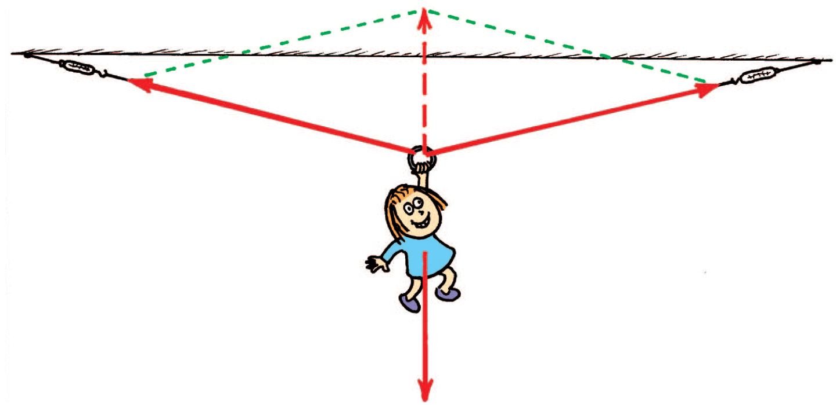
Applying the Parallelogram Rule
As the angle between the ropes increases, tension increases so that the resultant (dashed-line vector) remains at 300 N upward, which is required to support 300-N Nellie.

Slide 55
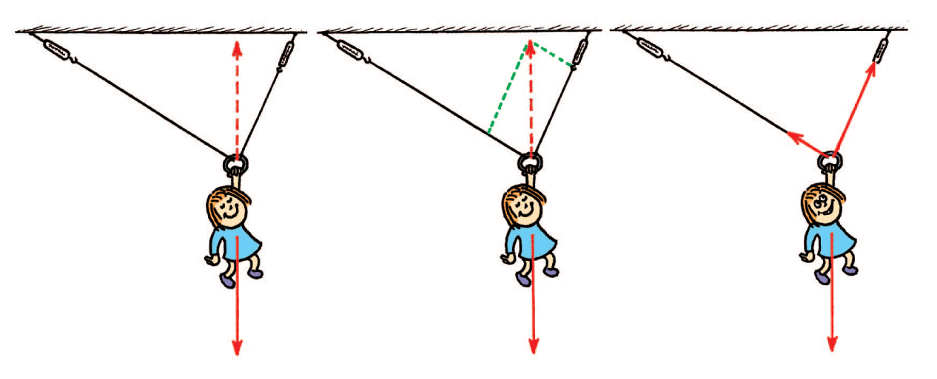
Applying the Parallelogram Rule
When the ropes supporting Nellie are at different angles to the vertical, the tensions in the two ropes are unequal.
By the parallelogram rule, we see that the right rope bears most of the load and has the greater tension.

Slide 56
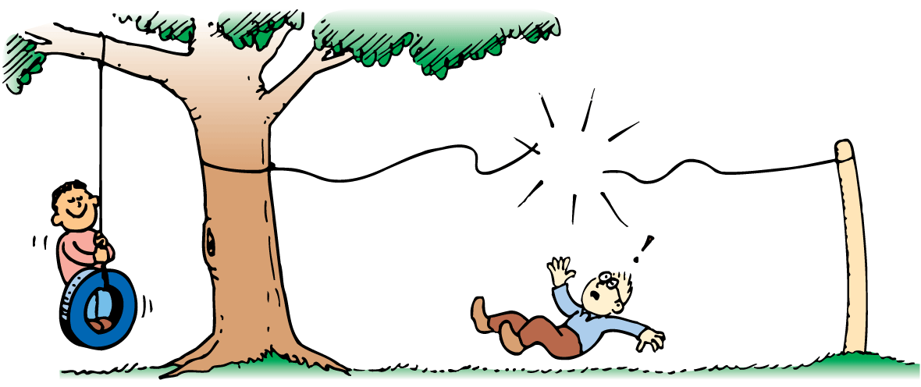
Applying the Parallelogram Rule
You can safely hang from a clothesline hanging vertically, but you will break the clothesline if it is strung horizontally.

Slide 57
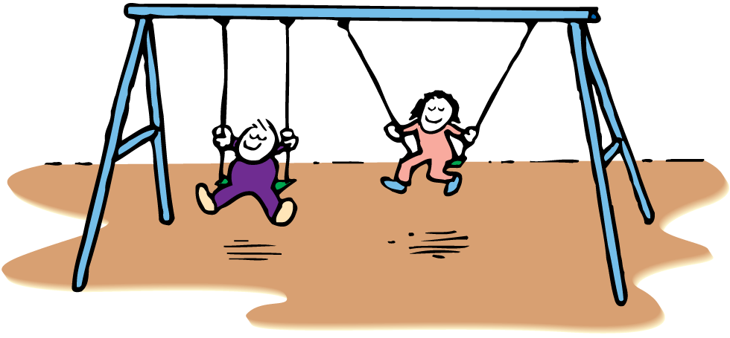
think!
Two sets of swings
are shown at right.
If the children on the
swings are of equal
weights, the ropes of
which swing are more likely to break?

Slide 58
think!
Two sets of swings
are shown at right.
If the children on the
swings are of equal
weights, the ropes of
which swing are more likely to break?
Answer: The tension is greater in the ropes hanging at an angle. The angled ropes are more likely to break than the vertical ropes.

Slide 59
think!
Consider what would happen if you suspended a 10-N object midway along a very tight, horizontally stretched guitar string. Is it possible for the string to remain horizontal without a slight sag at the point of suspension?

Slide 60
think!
Consider what would happen if you suspended a 10-N object midway along a very tight, horizontally stretched guitar string. Is it possible for the string to remain horizontal without a slight sag at the point of suspension?
Answer: No way! If the 10-N load is to hang in equilibrium, there must be a supporting 10-N upward resultant. The tension in each half of the guitar string must form a parallelogram with a vertically upward 10-N resultant.

